Slide 1
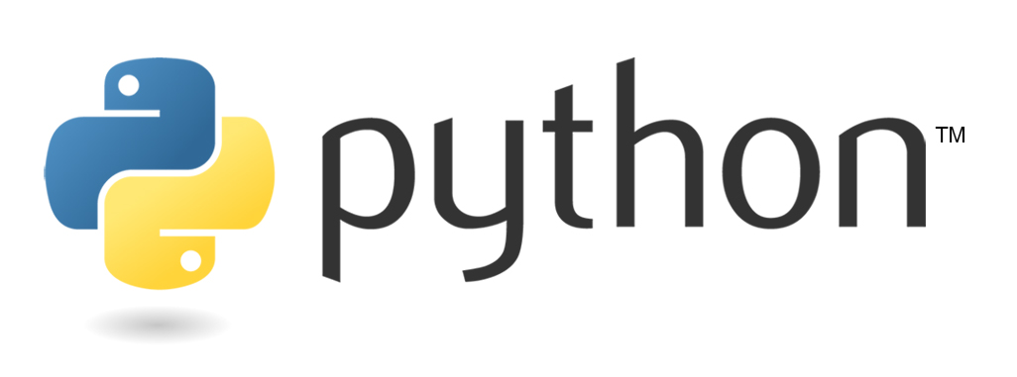

Bootcamp
Session 4
alphacloudone.com

Slide 2
Object Oriented Programming
Programming concept where objects can contain data and code
Most of the more commonly used programming languages out there are Object Oriented
Includes C++, JavaScript, Java, C# (.Net), and Python
In Python, Methods are the functions that are built into objects

Slide 3
Object Oriented Programming
We’ve already been using methods
.pop(), .sort()
No shortage of Methods available to use in Python
Libraries add even more

Slide 4
Object Oriented Programming
How do we get more information on Methods and Functions
In Jupyter, hit tab after the object to see available methods
Hit shift-tab to get detailed information
Run the help function
help(function)
Go to Docs.python.org
Google it

Slide 5
Functions
You can create your own functions in Python
Why?
Create repeatable blocks of code
Make a change once, instead of in multiple places
Foundational leap in your programming skills

Slide 6
Snake case name for your function
Empty parenthesis or name of input variable enclosed in parenthesis, followed by colon
Creating a Function
def function_name(input):
‘’’ this function does this’’’
some code
some more code
return(output)
Doc string enclosed in triple quotes explains what the function does as well as the required/optional inputs and outputs
The code your function will run, indented
def indicates you’re defining a new function
Optional return statement. When running the function, the output is the variable shown here

